Slide 1

MTN-025/HOPE
HIV Open-Label Prevention Extension (HOPE/MTN-025)
Protocol Summary

Slide 2

Beyond MTN-020/ASPIRE
A monthly vaginal ring containing dapivirine was safe and effective for HIV-1 prevention in African women.
Why do an open-label extension?
How have open-label extensions been done?
What do we contribute with MTN-025/HOPE?

Slide 3


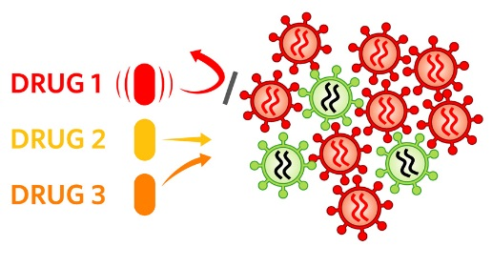


ASPIRE Key Result: Safety
The dapivirine vaginal ring was shown to be very safe
No difference in the number of adverse events (health problems), pregnancies, or HIV drug resistance was observed between study groups

Slide 4
ASPIRE Key Results: Efficacy
Overall, the ring prevented about one-third of HIV infections
Among women older than 21, more than half of HIV infections were prevented
Trends indicate higher protection with higher adherence – up to 71%
27%
56%
71%
Notes:
Adherence efficacy results to be presented at AIDS 2016 next week, and it gets even better!
The Ring Study had similar results to ASPIRE:
There were no safety concerns
Overall, the dapivirine vaginal ring resulted in a 31% reduction in the rate of HIV acquisition, compared to placebo

Slide 5
Results: Take Home Messages
The ring can reduce a women’s chance of HIV infection
Protection is highest when the ring is used all the time
The ring is not protective when it is not used
The ring is very safe to use

Slide 6
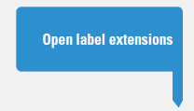
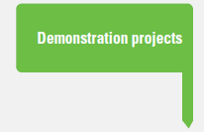
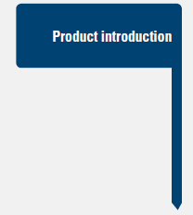


Why do an Open Label Extension?
The pathway from demonstration of efficacy to large-scale implementation is not instantaneous.
Providing access to the product is ethical and scientifically valuable
Open label extensions bridge efficacy to implementation = the OLE is the next step to get this ring out there!
Graphic: AVAC
Notes:
A core principle of ethical conduct of biomedical HIV prevention research is the provision of access to proven products in the immediate post-trial period.
There is an obligation for former participants to have the opportunity to access the dapivirine vaginal ring. As the ring is not yet licensed, access must be provided through a research protocol.

Slide 7
OLE Examples
 | Enrollment | Timeline to Implementation | Results
Partners PrEP Study Extension | 89% of those eligible | 3 months after results | High adherence and High HIV protection
iPrEx OLE | 65% of those eligible (of whom ~75% accepted PrEP [PrEP use was optional]) | 7 months after results | High adherence to open-label PrEP and high HIV protection with high adherence
CAPRISA 008 | 85% of those eligible | Protocol finalized 4 months after results; 2 year gap due to regulatory delays. | Pending

Slide 8
OLEs: Common Themes
All were implemented to provide access to an effective product
All included continued evaluation of safety among their primary goals, as well as adherence
All had time-limited follow-up and some gap between release of results and first enrollment (3 months to >2 years)
All had varying levels of uptake ranging from 65-89% of eligible participants
Results to date: high adherence, continued protection

Slide 9
OLEs lead to roll-out
We are now where oral tenofovir-based PrEP was 5 years ago:
  Imperfect efficacy in the first results (iPrEx = 44% overall, 59% among those ≥25 years, not significant for those <25 years)
  No studies except placebo-controlled trials – i.e., participants did not know it works, know it is safe, and know it is not placebo.
Why we need HOPE:
  As a placebo-controlled, investigational trial, ASPIRE could not answer whether women would have used the ring better if they had known it was effective and safe.

Slide 10
From ASPIRE to HOPE
ASPIRE & HOPE are different studies and we must think of them differently:
 | ASPIRE | HOPE
Design | Randomized, blinded trial | Open-label trial w/ no randomization or blinding
Placebo | Yes | No
Product | Unproven efficacy, may be placebo, unproven safety | Proven to prevent HIV, proven safe
Goal | Determine whether the ring was effective and safe | Show whether women will use the ring, when given the opportunity

Slide 11
From ASPIRE to HOPE
Even our Big 5 are different!
 | ASPIRE | HOPE
Accrual | Focus on “right” participants for an RCT | Offer the option to participate to every eligible woman from ASPIRE (but no recruitment target)
Retention | 95%+ | Still 95%+
Adherence | As high as possible (but unknown efficacy, safety, and might be placebo) | Choice to use ring (or not) When chosen, as high as possible & accurate reporting
Clinical & lab safety | Safety = co-primary outcome of the study & unknown | Safety = key outcome of the study but proven safe in ASPIRE
Data quality | Very important for this pivotal trial | Still important. Plus, new data system!

Slide 12
Key HOPE Messaging
CHOICE
ADHERENCE
ACCURATE REPORTING

Slide 13

Options in HIV Prevention:
A Client-Centered Counseling Approach
If your partner is HIV+, encourage ARV adherence
Use ring consistently
Use condoms consistently
Encourage partner to get tested for HIV
Encourage partner to get circumcised
Get treatment for STIs
Use oral PrEP
Engage in lower-risk sexual behaviours
Reduce your number of sex partners

Slide 14
Hope is Different than ASPIRE
Different in:
How we talk about the study
How we counsel about choices and adherence
How we define success in this study

Slide 15
MTN-025/HOPE:
What We Will Learn
Whether, when offered an effective and safe product, women take up the dapivirine vaginal ring, use it with high adherence and safety, and achieve HIV protection.
  In open-label studies of Truvada PrEP for HIV prevention adherence and HIV protection were considerably higher than in blinded, placebo-controlled trials. This strongly suggests that adherence and HIV protection will be higher in MTN-025/HOPE than in MTN-020/ASPIRE.
Understand acceptability and feasibility of delivery of the microbicide vaginal ring.
  A unique opportunity to deliver a microbicide and build community awareness of HIV prevention in women.

Slide 16

MTN-025/HOPE Objectives
Primary Objectives
  To characterize the safety profile associated with open label use of the dapivirine vaginal matrix ring (25 mg) in women
  To characterize adherence to open label use of the dapivirine VR
Secondary Objectives
  To assess the incidence of HIV-1 infection
  To assess the frequency of HIV-1 drug resistance
Exploratory Objectives
  To explore participant understanding of efficacy, ring acceptability, delivery feasibility, and describe the genital mircoenvironment.
  To characterize MTN-020 participants who choose not to enroll in MTN-025 (decliner population).

Slide 17
LoA#1 Key Modifications
Participants will be able to join HOPE independent of their decision to use the ring.
NEW exploratory objective: To characterize the MTN-020 participants who do not accept study product in MTN-025
ENDPOINT: Participant report of the factors that led to her decision to not accept study product
All language within the protocol regarding provision of study product and study product use instructions modified to “Offered study product”

Slide 18
LoA#1 Key Modifications
Add additional measures of ring use.
New Exploratory OBJECTIVE: To explore alternative markers of adherence
ENDPOINTS: Dapivirine levels in hair, Participant self-reported product use
Hair collection added as a procedure at all follow-up visits
IC updated to ensure participants are aware that they may receive results of testing that indicates their study product use (i.e. semi-real time feedback of objective measures)

Slide 19

LoA#1 Modifications (Other)
Incorporates results from IPM 027 (The Ring Study) and MTN-020 (ASPIRE)
Removes the protocol requirement to use FDA-approved HIV testing kits for HIV infection confirmation
Allows the use of audio files as source documents for in-depth interview data
Updates the DAIDS Adverse Event (AE) Grading Table from Version 1.0 to 2.0
Updates the Protocol Team Roster and DAERS contact information

Slide 20
MTN-025/HOPE Population
Study Population: Former MTN-020 participants who are HIV-uninfected and not pregnant
  Decliner Population: Former MTN-020 participants who decline participation in the main MTN-025 study and meet eligibility criteria for decliner group
Sites: Approved former ASPIRE sites
Study Design: Phase 3B, open-label, multi-site trial
Study Duration: Approximately 13 months of follow-up per participant with a projected accrual period of approximately 6 months at each site.
Study Product: Dapivirine Vaginal Ring, 25 mg, replaced monthly

Slide 21
MTN-025/HOPE Design
SCR
M6
M9
Exit / Term
ENR
M1
M2
M3
M12
Visit Schedule: Monthly for the first three months, then quarterly thereafter (non-randomized)
    A goal to assess a more “real world” frequency for clinic follow-up and distribution of rings
Study Procedures: HIV testing, risk-reduction counseling, pregnancy testing, contraceptive counseling/provision, behavioral data collection, safety monitoring, product counseling/provision

Slide 22
MTN-025/HOPE: Summary
In accordance with international ethical principles regarding the conduct of HIV-1 prevention research, MTN-025/HOPE will provide access to dapivirine VR for former ASPIRE participants
Additionally, MTN-025 will provide information on the following key scientific outcomes:
  Important data on safety with open-label use, coincident with regulatory submission of dapivirine VR
  Assessment of adherence with open-label use, transitioning from monthly clinical trial visits to quarterly visits to mimic delivery settings
  Measurement of the key outcomes of HIV-1 incidence and resistance once efficacy is known
  Understanding declines of the ring (as one prevention tool is not for everyone)

Slide 23


Sister Studies: OLEs
 | DREAM (IPM 032) | HOPE (MTN-025)
Primary Objective | Long-term safety and adherence
Design | Open-label
No. of participants | Follow-on to IPM 027 | Follow-on to MTN-020
Follow-up Regimens | Initially 1-monthly Routinely 3-monthly (2 additional rings)
Treatment Regimen | 1-monthly ring replacement
Product use period | Approx. 1-year follow-up with option to extend
Expected Start Date | 2016
23
Notes:
The two open-label follow-on trials to IPM 027 and MTN-020 that are planned are IPM 032 (DREAM) and MTN-025 (HOPE)
As can be seen from this slide, the designs of the two trials are similar:
- both will be evaluating the long-term safety of and adherence to ring use
- both are open-label (all participants who participated in IPM 027 and MTN-020 will be offered enrolment in these two trials)
- the planned follow-up schedule for the 2 trials is monthly run-in visits for the first 3 months, and then moving to quarterly visits, when 2 additional rings will be dispensed at each visit. This visit schedule is anticipated to mimic the “real-world” situation after roll-out.
- Women will use the rings for approximately 1 year, with the option to extend.

Slide 24

HOPE Resources and Communications

Slide 25
HOPE Management Team
Protocol Chairs:
FHI 360:
MTN LC:
MTN Pharmacy:
SCHARP:
Behavioral:
Pitt LOC/Regulatory:
Jared Baeten, Thesla Palanee-Phillips, Nyaradzo Mgodi
Ashley Mayo (MRC/Wits RHI), Rachel Scheckter (Uganda/Zim/Cape Town), Morgan Garcia (eThekwini/Lilongwe/Blantyre)
Ted Livant, Urvi Parikh
Cindy Jacobson, Lindsay Kramzer
Jennifer Berthiaume, Melissa Peda
Ariana Katz, Kenneth Ngure, Ariane van der Straten, Ivan Balan
Judy Jones, Luis Duran
Community Team: Rhonda White, Jontraye Davis

Slide 26

HOPE Communication Plans
Weekly Priority Emails
Implementation Calls with FHI 360 CRM
Monthly HOPE Protocol Team Calls
Monthly HOPE CWG calls

Slide 27
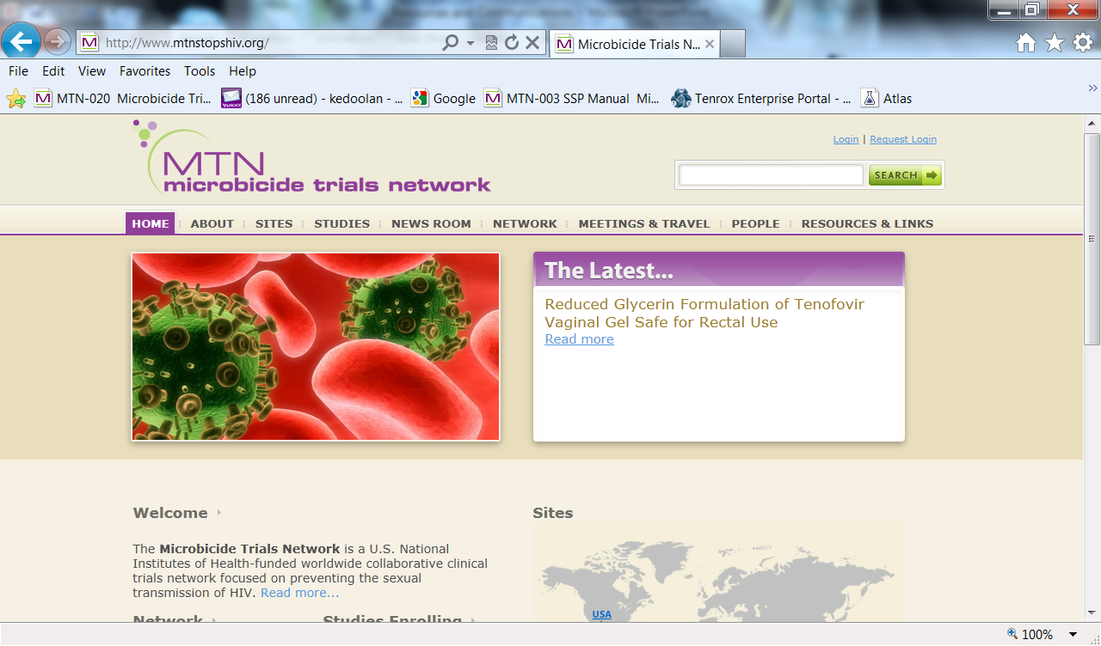

MTN Website
http://www.mtnstopshiv.org/

Slide 28
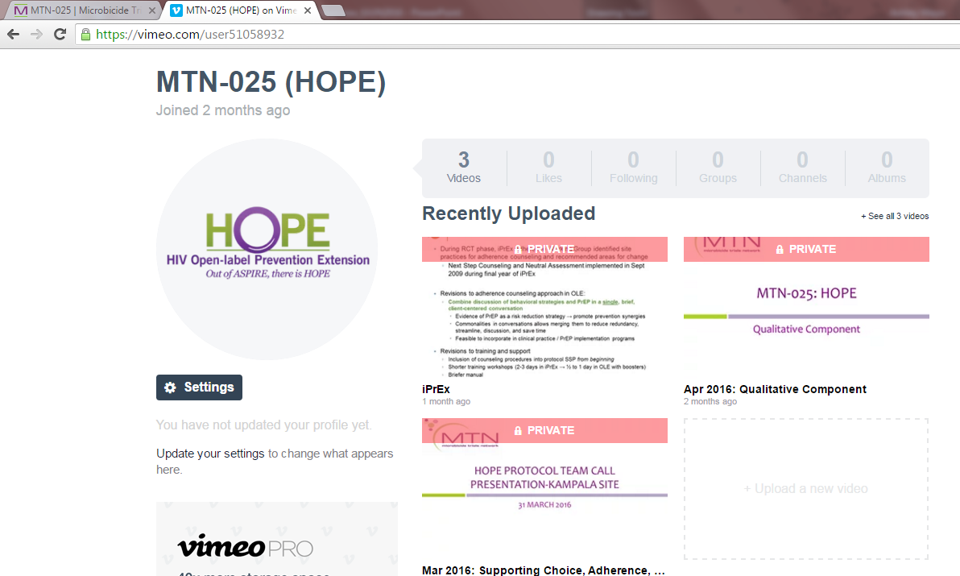
HOPE Vimeo Site

Slide 29
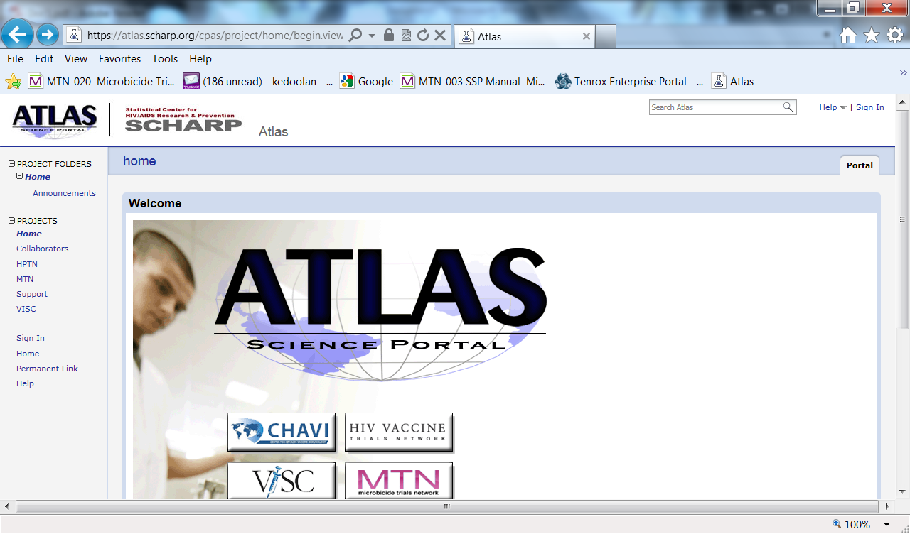
Atlas portal
https://atlas.scharp.org/cpas/project/home/begin.view

Slide 30
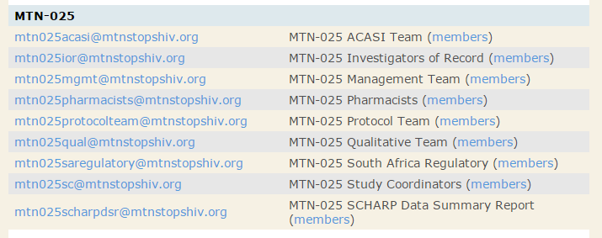
Alias lists and team communication

Slide 31
Thank you!
Questions??

